Slide 1
March, 2018
ASP.NET
Ihnat Klimchuk

Slide 2
Hi there.
I’m Ihnat Klimchuk
Department: D3 G2
Technologies: .NET, JS, HTML, CSS, SQL
Software Engineer
Contact Information:
Phone: +375 29 148 43 71
Email: ihnat.klimchuk@itechart-group.com
Skype: ignatks47

Slide 3
LECTURE CONVENTION
TODO

Slide 4
History MILESTONES
1996 – ASP (Active Server Pages)
2002 – ASP.NET (ASP+)
2008 – ASP.NET MVC
2010 – ASP.NET Web Pages (Razor)
2012 – ASP.NET Web API, SignalR
2016 – ASP.NET CORE (ASP.NET 5, vNext)
2018 – You are here

Slide 5
Active Server Pages Facts
Released by Microsoft in 1996
ASP remains supported until 14 January 2020
ASP uses server-side scripting
ASP interpreter supports VBScript, PerlScript and JScript
JScript !== JavaScript

Slide 6
Code sample
<%
Response.Write "Hello World!"
%>
<% @ Language = "JScript" %><%
Response.Write("Hello World!");
%>

Slide 7
ASP.NET Facts
Released in 2002
Compiled code
Based on .NET Framework
ASP.NET supports CLR languages (C#, VB.NET, F#, etc.)
Ability to use the code-behind development model
Extensions

Slide 8
ASP.NET Extensions
ASP.NET MVC
ASP.NET RAZOR (Web Pages)
ASP.NET Web API
ASP.NET SignalR
ASP.NET Web Forms
Others (ASP.NET Dynamic Data, ASP.NET AJAX, etc.)

Slide 9
ASP.NET CORE Facts
Released in 2016
Light-weight and modular HTTP request pipeline
Cross-platform
Based on .NETSTANDARD (.NET Framework or Core)
Modular and distributed as Nuget packages
Open-source

Slide 10
SHORT OVERVIEW
ASP
ASP.NET
ASP.NET CORE
1996
2002
2016

Slide 11
SHORT OVERVIEW
ASP.NET
ASP.NET MVC
ASP.NET Web API
ASP.NET SignalR
ASP.NET RAZOR
ASP.NET Web Forms
Others

Slide 12
Questions
Feel free to ask anything

Slide 13
WEBSITE TYPES in THEORY
Multi page website
Single page website
Server side rendering
Client side rendering
Web API

Slide 14
WEBSITE TYPES in practice
Multi page website
Single page website
Server side rendering
Client side rendering
Web API

Slide 15
ASP.NET MVC
Deep Dive

Slide 16
HIGH LEVEL OVERVIEW
Browser
Internet
IIS
ASP.NET

Slide 17
Mvc PATTERN
Controller
Model
View

Slide 18
MVC in ASP.NET (NOT ORIGINAL)
Controller
Model
View

Slide 19
Quote of the day
Talk is cheap. Show me the code.
Linus Torvalds

Slide 20
TOOLS
Visual Studio
.NET Framework
Brains

Slide 21
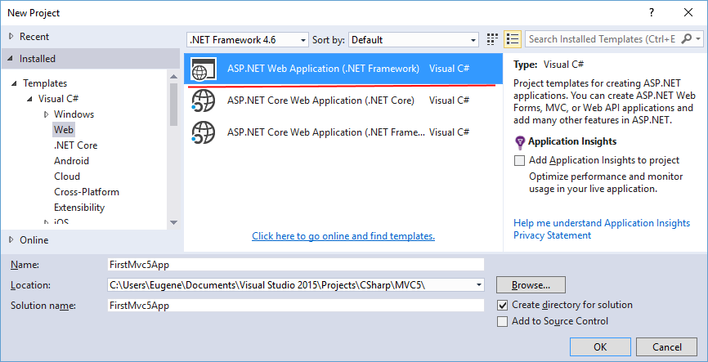
Create New Project

Slide 22
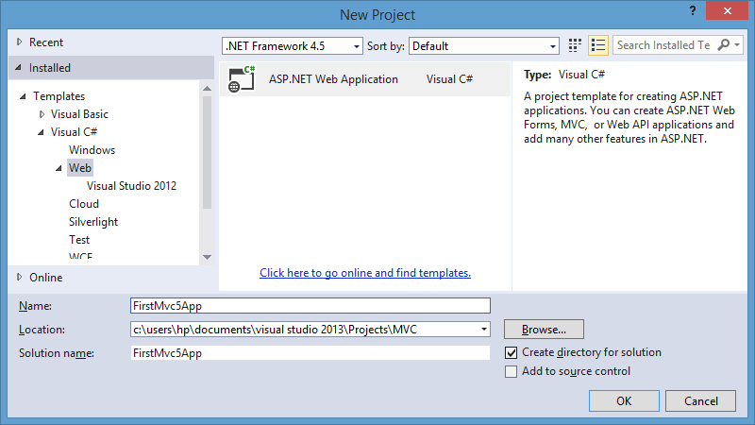
Create New Project

Slide 23
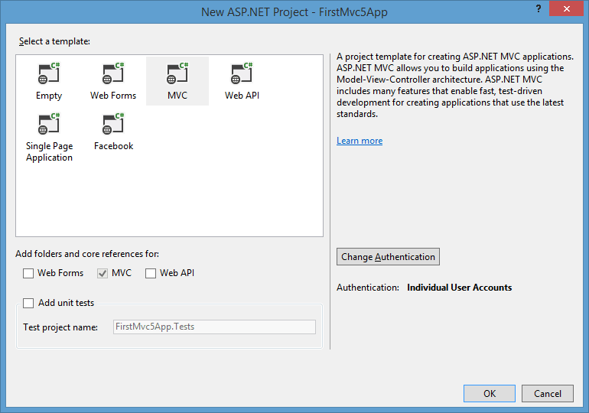
Create New Project

Slide 24
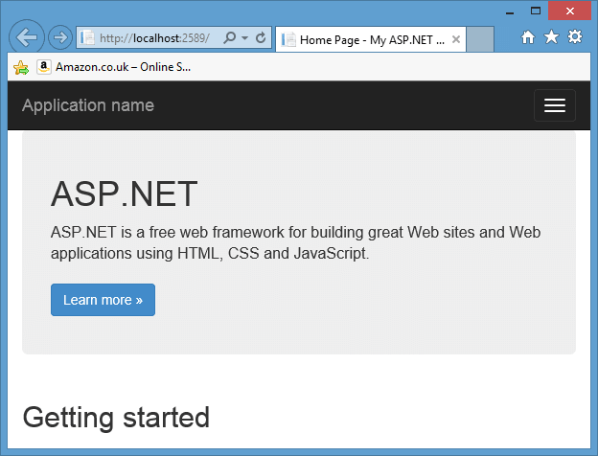
Create New Project

Slide 25
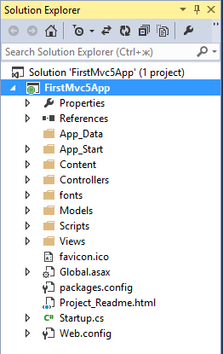
Create New Project

Slide 26
TASK 1: Static page WEBSITE
For GET request url example.com I want to see static page TODO – REWORK!

Slide 27
Router
public class RouteConfig
{
public static void RegisterRoutes(RouteCollection routes)
{
routes.IgnoreRoute("{resource}.axd/{*pathInfo}");
routes.MapRoute(
name: "Default",
url: "{controller}/{action}/{id}",
defaults: new { controller = "Home",
action = "Index",
id = UrlParameter.Optional }
);
}
}

Slide 28
HOME Controller
public class HomeController : Controller
{
public ActionResult Index()
{
return View();
}
}

Slide 29
HOME VIEW
CODE SNIPPET
<!DOCTYPE html>
<html>
<head>
<title>Home</title>
</head>
<body>
<div>Hello, this is home page.</div>
</body>
</html>

Slide 30
Congratulations! You know ASP.NET!
Not really…

Slide 31
TASK 2: Static 2 page WEBSITE
For GET request url example.com I want to see static page TODO – REWORK!

Slide 32
Router – NO CHANGES
public class RouteConfig
{
public static void RegisterRoutes(RouteCollection routes)
{
routes.IgnoreRoute("{resource}.axd/{*pathInfo}");
routes.MapRoute(
name: "Default",
url: "{controller}/{action}/{id}",
defaults: new { controller = "Home",
action = "Index",
id = UrlParameter.Optional }
);
}
}

Slide 33
HOME Controller
public class HomeController : Controller
{
public ActionResult Index()
{
return View();
}
public ActionResult About()
{
return View();
}
}

Slide 34
ABOUT VIEW
CODE SNIPPET
<!DOCTYPE html>
<html>
<head>
<title>About</title>
</head>
<body>
<div>Hello, today is ???</div>
</body>
</html>

Slide 35
Let’s READ THE DOCS

Slide 36
View Engine
View Engine is responsible for the transformation of views into HTML, XML, or some other type of content.
View
View Engine
Content

Slide 37
Razor View Engine
Compact, Expressive, and Fluid
Easy to Learn
Is not a new language
Works with any Text Editor
Has great Intellisense
Unit Testable

Slide 38
RAZOR Example
CODE SNIPPET
<!-- Single statement block -->
@{ var myMessage = "Hello World"; }
CODE SNIPPET
<!-- Inline expression or variable -->
<p>The value of myMessage is: @myMessage</p>
CODE SNIPPET
<!-- Multi-statement block -->
@{
var greeting = "Welcome to our site!";
var weekDay = DateTime.Now.DayOfWeek;
var greetingMessage = greeting + " Here in Huston it is: " + weekDay;
}
<p>The greeting is: @greetingMessage</p>

Slide 39
RAZOR Example
CODE SNIPPET
@if (DateTime.Now.Year != 2007)
{
<p>Today is @DateTime.Now</p>
}
else
{
<p>O-la-la!</p>
}
CODE SNIPPET
@{
foreach (int item in array)
{
@(string.Format("Item is {0}", item))<br/>
}
}

Slide 40
RAZOR Example
CODE SNIPPET
@*
Comment
Comment
Comment
*@
@{
//Comment
}

Slide 41
LAYOUT
Layout eliminates constant repetition of the same structures and unnecessary copying.
_Layout.cshtml
Page1.cshtml
Page2.cshtml

Slide 42
Layout
CODE SNIPPET
@*~/Views/Shared/_Layout.cshtml*@
<!DOCTYPE html>
<html>
<head>
<title>Layout</title>
</head>
<body>
@RenderBody()
</body>
</html>
CODE SNIPPET
@*Page.cshtml*@
@{
Layout = " ~/Views/Shared/_Layout.cshtm";
}
<p>This is Partial View</p>

Slide 43
Section
CODE SNIPPET
@*~/Views/Shared/_Layout.cshtml*@
…
@RenderBody()
<footer>@RenderSection("Footer")</footer>
…
CODE SNIPPET
@{
Layout = "../Shared/_Layout.cshtml";
}
@section Footer
{
<p>This is footer</p>
}
<p>This is Partial View</p>

Slide 44
Section
CODE SNIPPET
@*~/Views/Shared/_Layout.cshtml*@
…
@RenderBody()
<footer>@RenderSection("Footer")</footer>
<footer>
@if (IsSectionDefined("Footer")) {
@RenderSection("Footer")
}
else
{
<span>Default footer</span>
}
</footer>
…
CODE SNIPPET

Slide 45
Other Stuff To see
PartialView functionality
RenderPage functionality
Component functionality
Other

Slide 46
FROM CONTROLLER TO VIEW
ViewData
ViewBag
Session
Model

Slide 47
ViewData
CODE SNIPPET
public ActionResult TestViewData()
{
ViewData["TestData"] = "This is ViewData";
return View();
}
CODE SNIPPET
<html>
<head>…</head>
<body>@ViewData["TestData"]</body>
</html>

Slide 48
ViewBag
CODE SNIPPET
public ActionResult TestViewBag()
{
ViewBag.TestData = "This is ViewBag";
return View();
}
CODE SNIPPET
<html>
<head>…</head>
<body>@ViewBag.TestData</body>
</html>

Slide 49
MODEL
Model
CODE SNIPPET
public class HomeModel
{...}
CODE SNIPPET
public ActionResult StrongTypeView ()
{
HomeModel model = new HomeModel();
return View(model);
}
CODE SNIPPET
@model HomeModel
<html>
<head>
<title>Strong Type</title>
</head>
<body>@Model.Field1</body>
</html>
PRESENTATION NAME

Slide 50
Model
CODE SNIPPET
public ActionResult StrongTypeView ()
{
var model = new { test = "Test" };
return View(model);
}
CODE SNIPPET
@model dynamic
<html>
<head>
<title>Dynamic</title>
</head>
<body>@Model.test</body>
</html>
PRESENTATION NAME

Slide 51
HTML Helper
CODE SNIPPET
@helper ListArrayItems(string[] array)
{
foreach (string item in Model.Values)
{
<text>@item</text>
}
}
<html>
<head>
<title> Inline HTML Helpers</title>
</head>
<body>
@ListArrayItems(Model.Values)
</body>
</html>

Slide 52
HTML Helper
CODE SNIPPET
public static class CustomHelpers
{
public static MvcHtmlString ListArrayitems(this HtmlHelper html,
string[] list)
{
TagBuilder tag = new TagBuilder("ul");
foreach (string str in list)
{
TagBuilder itemTag = new TagBuilder("li");
itemTag.SetInnerText(str);
tag.InnerHtml += itemTag.ToString();
}
return new MvcHtmlString(tag.ToString());
}
}

Slide 53
HTML Helper
CODE SNIPPET
@using WorkWithHtmlHelpers.Helpers.HtmlHelpers
...
<div>
@Html.ListArrayitems(Model.Values)
</div>
...

Slide 54
HTML Helper
CODE SNIPPET
@using (Html.BeginForm("CreateForm", "StandartHtmlHelpers", FormMethod.Post, new {@class = "text-form"}))
{
...
}

Slide 55
HTML Helper
CODE SNIPPET
@Html.CheckBox("myCheckbox", false)
@Html.Hidden("myHidden", "val")
@Html.RadioButton("myRadiobutton", "val", true)
@Html.Password("myPassword", "val")
@Html.TextArea("myTextarea", "val", 5, 20, null)
@Html.TextBox("myTextbox", "val")
@Html.DropDownList("myList", new SelectList(new [] {"A", "B"}), "Choose")
@Html.ListBox("myList", new MultiSelectList(new [] {"A", "B"}))

Slide 56
HTML Helper
CODE SNIPPET
@Html.CheckBoxFor(x => x.IsApproved)
@Html.HiddenFor(x => x.SomeProperty)
@Html.RadioButtonFor(x => x.RadioVal, "val")
@Html.PasswordFor(x => x.Password)
@Html.TextAreaFor(x => x.Bio, 5, 20, new{})
@Html.TextBoxFor(x => x.Name)
@Html.DropDownListFor(x => x.Gender, new SelectList(new [] {"M", "F"}))
@Html.ListBoxFor(x => x.Vals, new MultiSelectList(new [] {"A", "B"}))

Slide 57
HTML Helper
CODE SNIPPET
@Url.Content("~/Content/image.jpg")
@Html.ActionLink("Hi", "Index", "Link")
@Html.ActionLink("Hi", "Index", "Link", "https", "www.test.com", "anchor", new{}, null)
@Url.Action("Index", "Link")
@Url.RouteUrl(new { controller = "Link", action = "Index" })
@Html.RouteLink("Hi", new { controller = "Link", action = "Index" }, null)
@Html.RouteLink("Hi", "myNamedRoute", new {})

Slide 58
HTML Helper
CODE SNIPPET
@Html.TextBoxFor(x => x.Name, new {@class = "my-css-class", customAttribute = "custom"})

Slide 59
TASK 3: FORMS AND VALIDATION
For GET request url example.com I want to see static page TODO – REWORK!

Slide 60
Validation Attributes
[Required]
[EmailAddress]
[Range(1, 5)]
[Phone]
[FileExtensions]
[RegularExpression(@"\d+")]
[StringLength(5, MinimumLength = 3)]

Slide 61
Model Validation
CODE SNIPPET
public class UserViewModel
{
[Required]
[MinLength(3)]
public string FirstName { get; set; }
[Required]
public string LastName { get; set; }
[Required]
public string Email { get; set; }
[Required]
[MinLength(3)]
public string Password { get; set; }
}

Slide 62
Validation in Controller
CODE SNIPPET
public ActionResult SaveUser(UserViewModel user)
{
if (ModelState.IsValid)
{
return View(“Success");
}
return View(“Error");
}

Slide 63
TASK 4: CLIENT VALIDATION
For GET request url example.com I want to see static page TODO – REWORK!

Slide 64
Bundles
Bundles are added to page using special HTML helpers:
Styles.Render
Scripts.Render
CODE SNIPPET
<head>
<meta charset="utf-8" />
<meta name="viewport" content="width=device-width, initial-scale=1.0">
<title>@ViewBag.Title - My ASP.NET Application</title>
@Styles.Render("~/Content/css")
@Scripts.Render("~/bundles/modernizr")
</head>

Slide 65
Client Validation
Config
CODE SNIPPET
<configuration>
<appSettings>
<add key="ClientValidationEnabled" value="true" />
<add key="UnobtrusiveJavaScriptEnabled" value="true" />
</appSettings>
</configuration>
JavaScript Libraries
CODE SNIPPET
<script src="@Url.Content("~/Scripts/jquery.js")"></script>
<script src="@Url.Content("~/Scripts/jquery.validate.js")"></script>
<script src="@Url.Content("~/Scripts/jquery.validate.unobtrusive.js")"></script>
PRESENTATION NAME

Slide 66
Client Validation. Page markup
CODE SNIPPET
<div>
<div class="editor-label">
First Name:
</div>
<div class="editor-field">
@Html.TextBoxFor(item => item.FirstName)
@Html.ValidationMessageFor(item => item.FirstName)
</div>
</div>

Slide 67
Client Validation. Page markup
CODE SNIPPET
<div>
<div class="editor-label">
First Name:
</div>
<div class="editor-field">
@Html.TextBoxFor(item => item.FirstName)
@Html.ValidationMessageFor(item => item.FirstName)
</div>
</div>

Slide 68
Localization of Validation Messages
Localization based on attributes' properties
CODE SNIPPET
[Required(ErrorMessage = @"This is required field.")]
[StringLength(20, MinimumLength = 3,
ErrorMessageResourceType = typeof(ValidationLocalizations),
ErrorMessageResourceName = "StringLengthError")]

